Slide 1

Hispanic Woman Owned Business Enterprise

Slide 2

FIRM OVERVIEW

Slide 3
Organization Chart
Marcella Lancome
President & CEO
Marcella Lancome
President & CEO
Richard Ness, RA
Director of
Project Development
Claude Lancome, Esq.
Executive
Vice President
Suzanne Slater
Director of
Administration
Business Advisors
Accounting Firm
Law Firm
Insurance Firm
IT Firm
Web Services Firm
Richard Ness, RA
Director of
Project Development
Claude Lancome, Esq.
Executive
Vice President
Suzanne Slater
Director of
Administration
Business Advisors
Accounting Firm
Law Firm
Insurance Firm
IT Firm
Web Services Firm
Senior Project Managers
David Keller
Andrea Jones
Project Managers
Clerks of the Works
Technical
Consultants
Senior Project Managers
David Keller
Andrea Jones
Project Managers
Clerks of the Works
Technical
Consultants
Pre-Qualified Professionals and Sub-consultants
Pre-Qualified Professionals and Sub-consultants

Slide 4
UPDATED CLIENT LIST

Slide 5
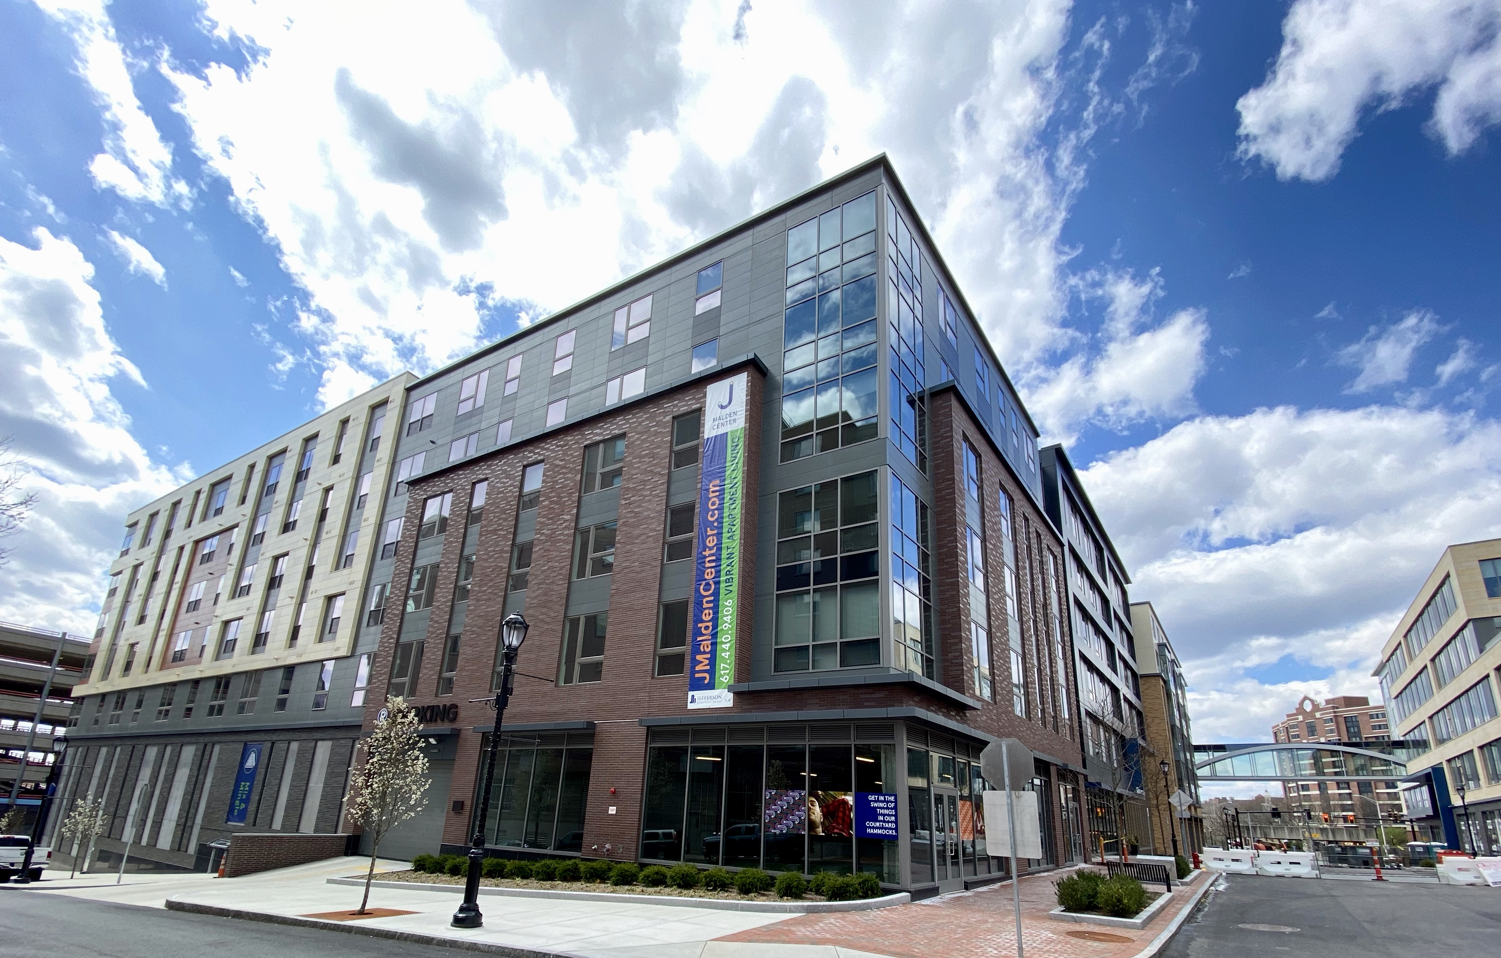
Updated Client List
Northwestern Mutual Insurance Company
Due Diligence including Property Condition Reports and Project Monitoring
Project values:
$100 million to $150 million

Slide 6
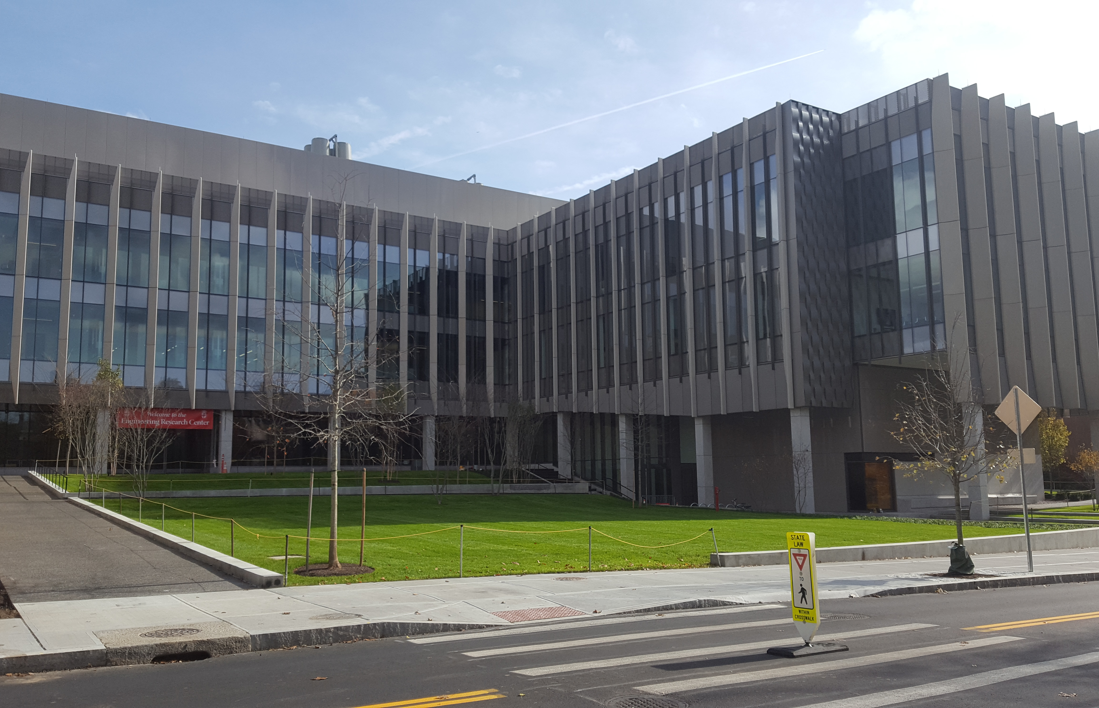
Updated Client List
Brown University
Review designer and contractor draws for Performing Arts Center
Project value:
$150 million

Slide 7
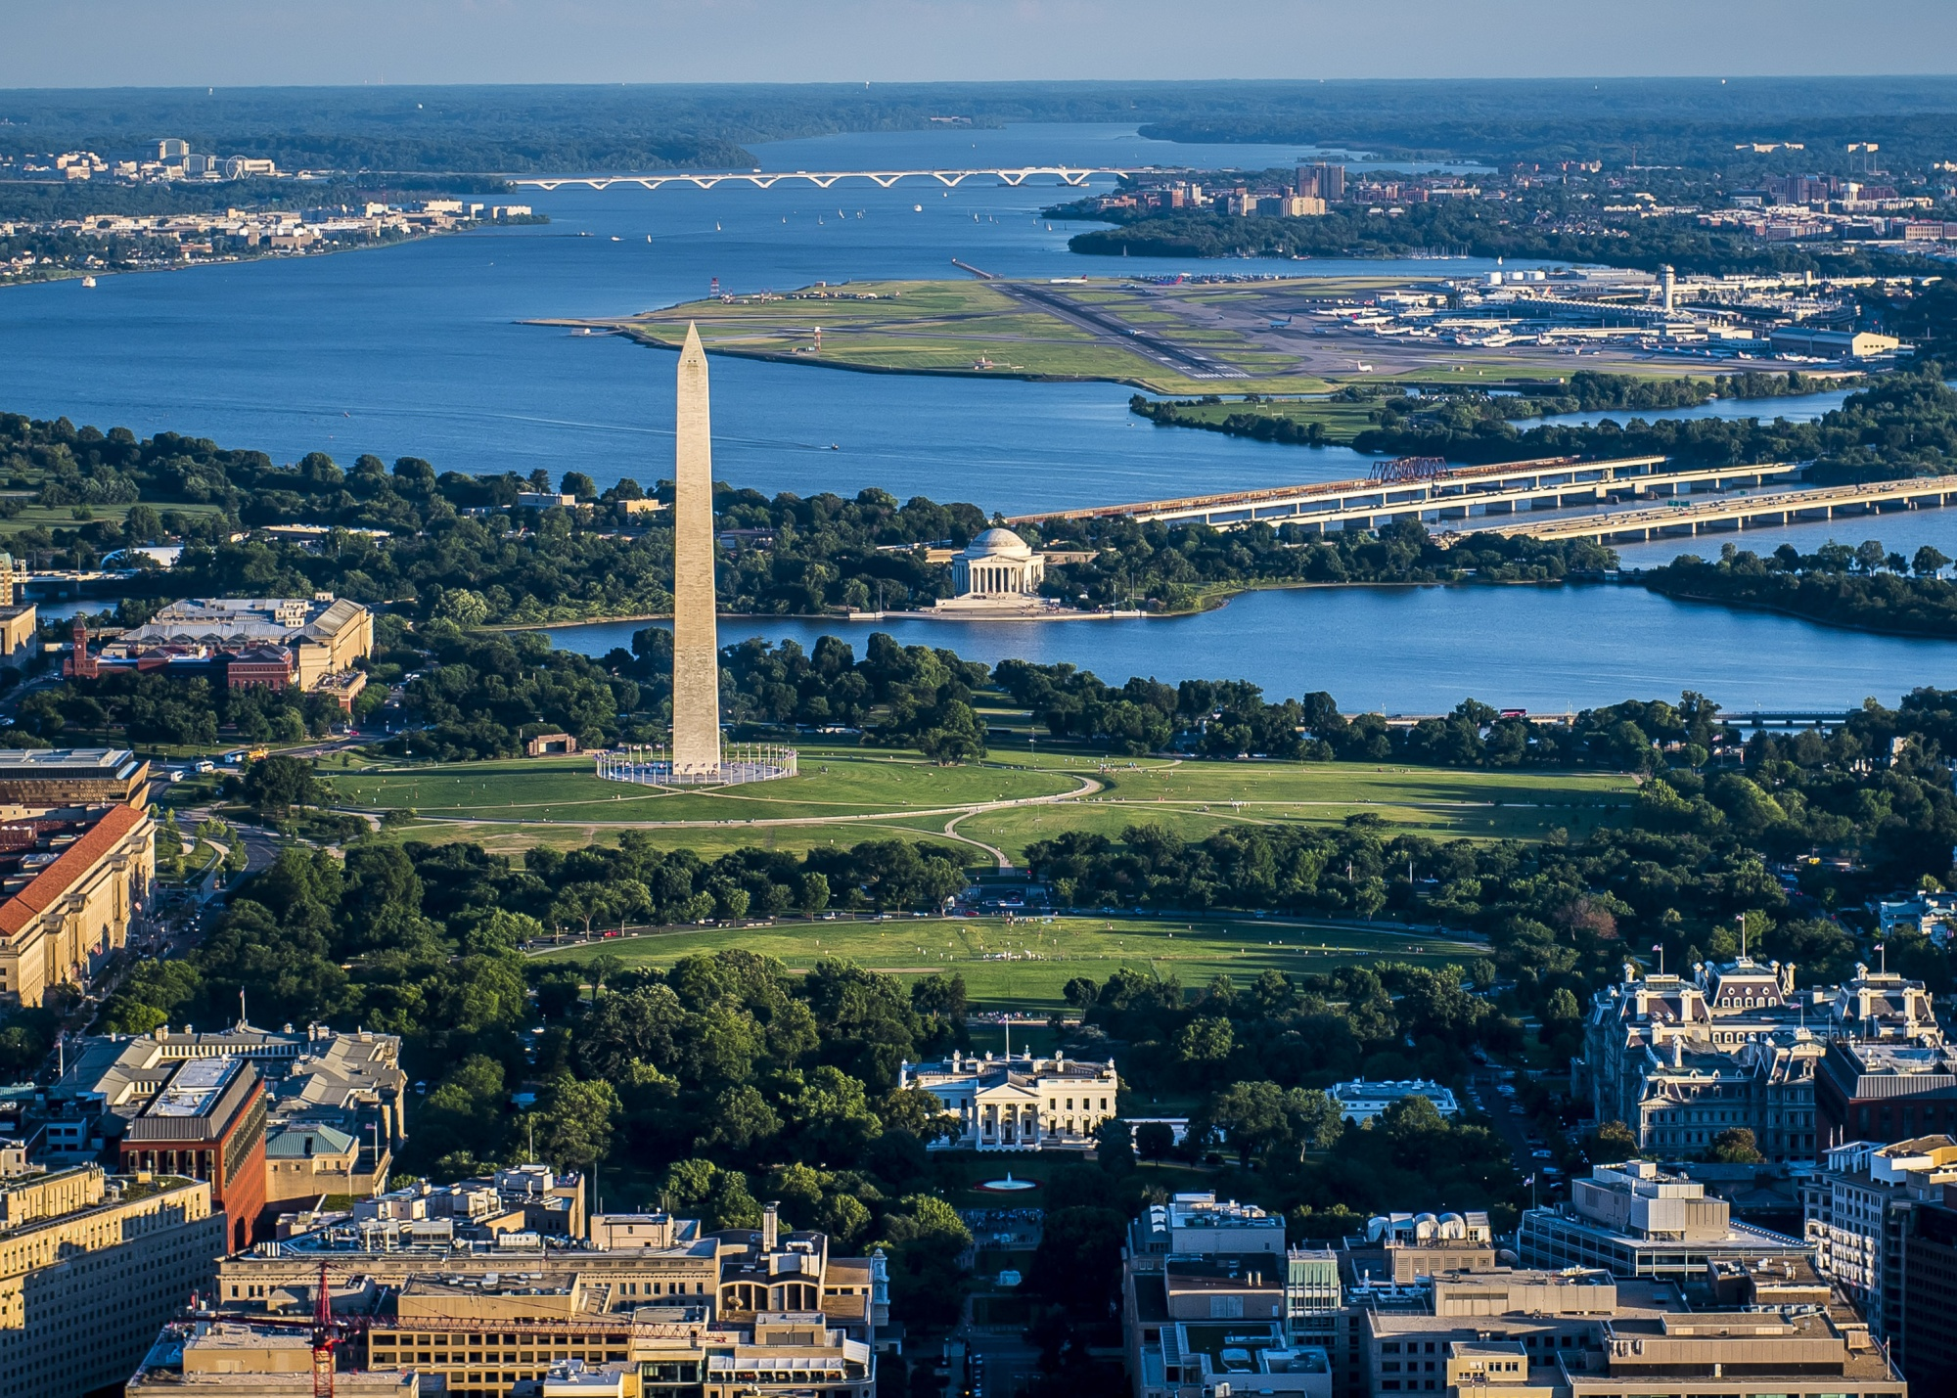
Updated Client List
U.S. General Services Administration (GSA), National Capital Region
Program Management Support;
Ten full-time Senior Project Managers managing office fit-out projects
Aggregate value of all projects:
$500,000,000

Slide 8
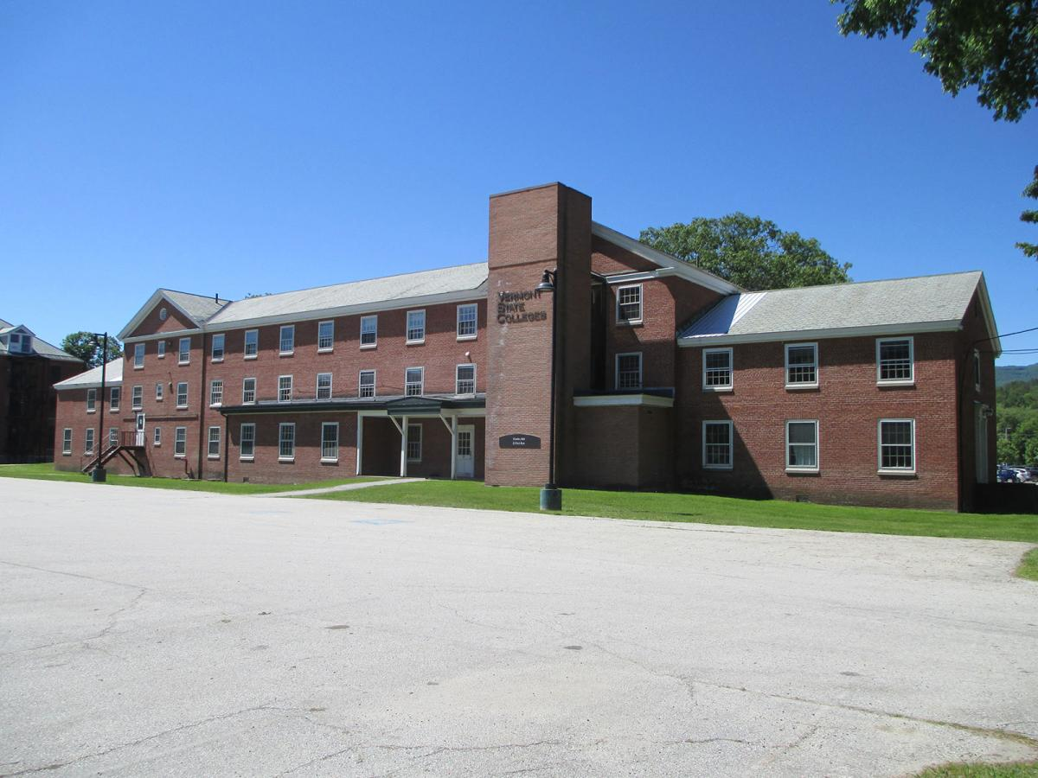
Updated Client List
State of Vermont
Project Management for demolition of two state owned buildings
Project value:
$400,000

Slide 9

Updated Client List
University of Massachusetts Building Authority
Prequalified to serve Authority
as Owner’s Representative for
Public-Private Partnership (P3) projects

Slide 10
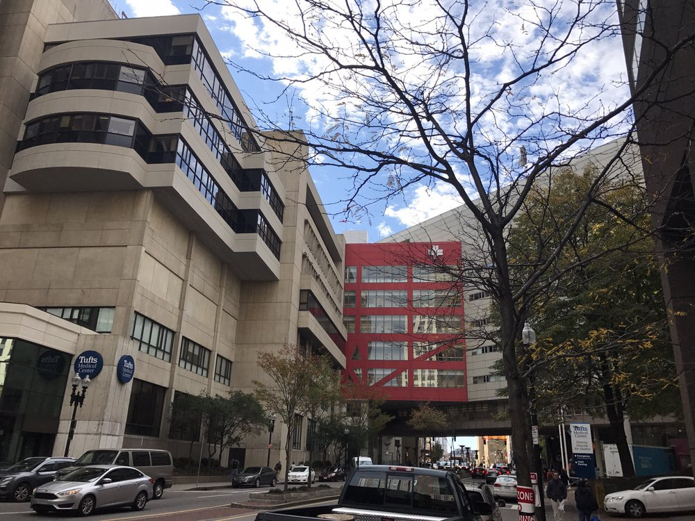
Updated Client List
Tufts Medical Center
Manage multiple ADA related projects in multiple buildings
(Project on hold due to COVID-19)

Slide 11
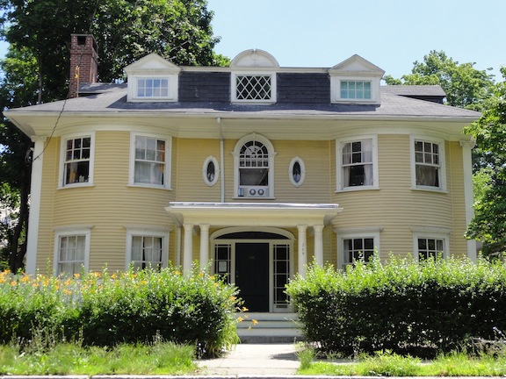
Updated Client List
Massachusetts Institute of Technology
Manage upgrade of life safety systems in 35 independent houses
(Project on hold due to COVID-19)

Slide 12
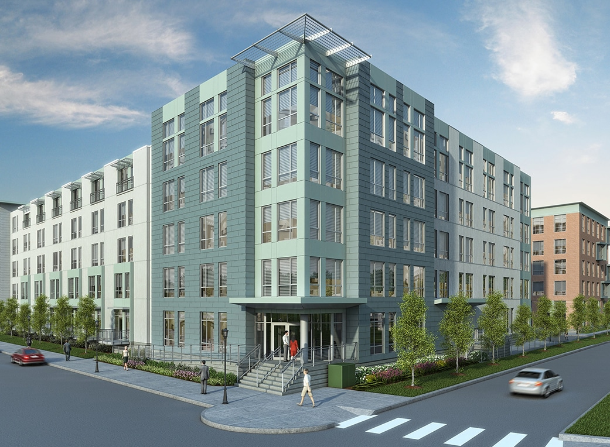
Updated Client List (Last three years)
Private Investor
Project Monitoring Services,
Hub 25 Apartment Complex
Project value:
$85 million

Slide 13
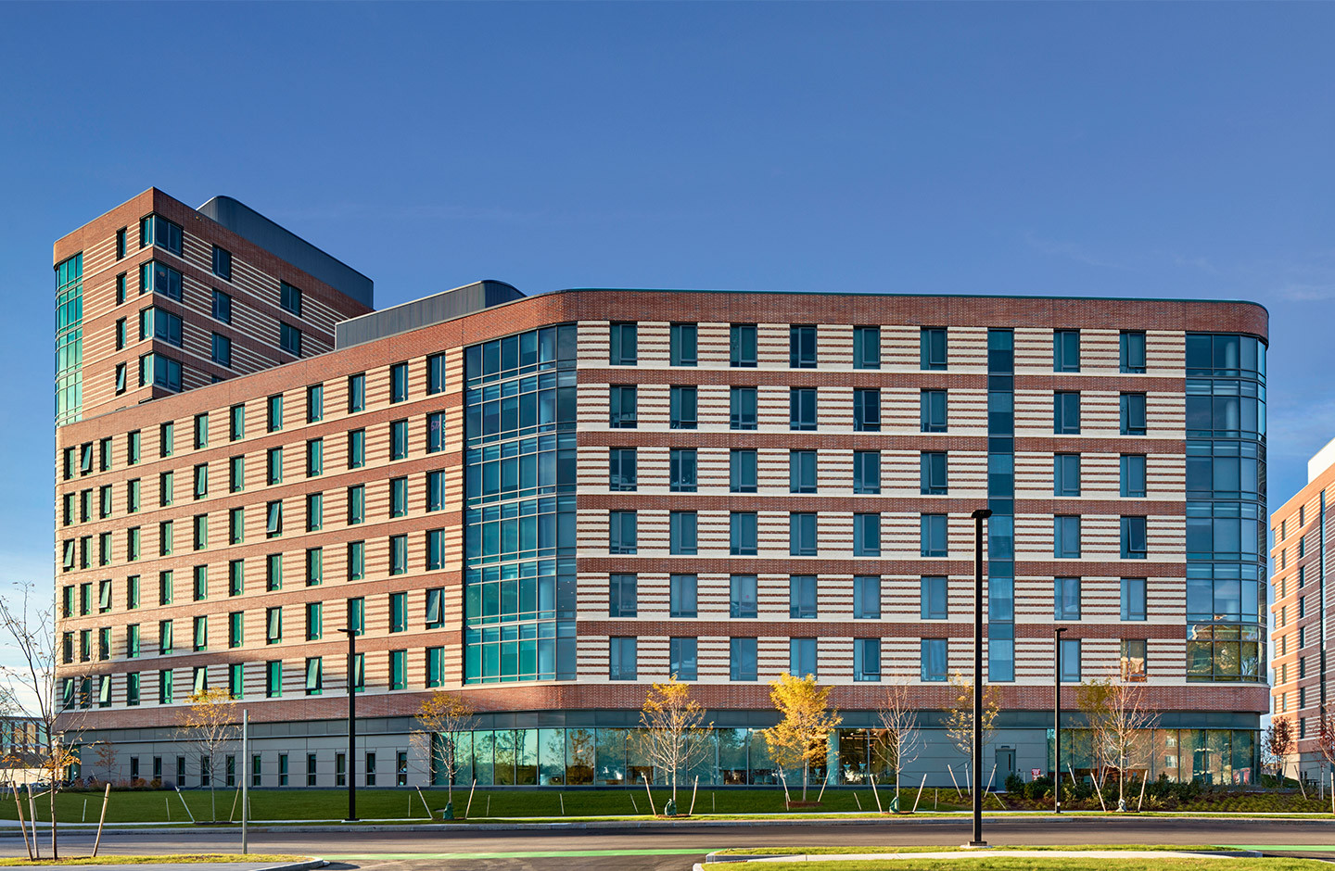
Updated Client List (Last three years)
Capstone
Development
On-site Construction Manager,
new dormitory UMass Boston
Project value:
$115 million

Slide 14
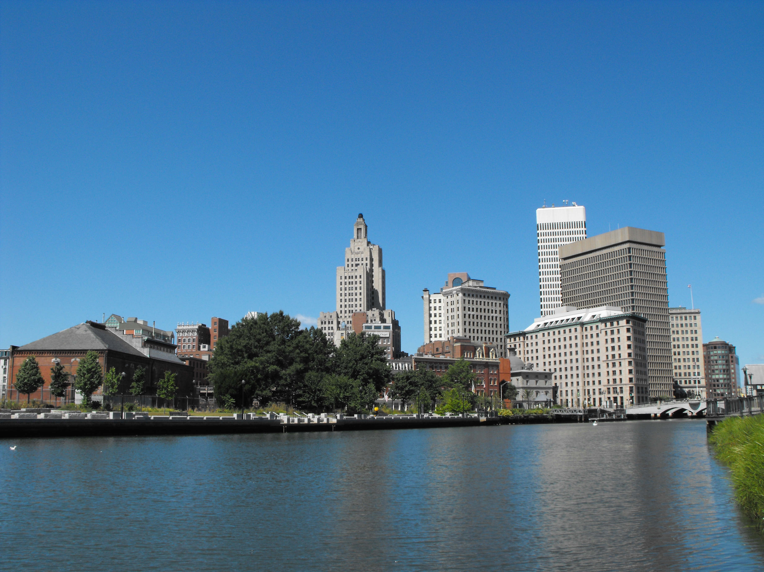
Updated Client List (Last three years)
City of Providence
Program Manager for Capital Improvement Program
Project value:
$78 million

Slide 15
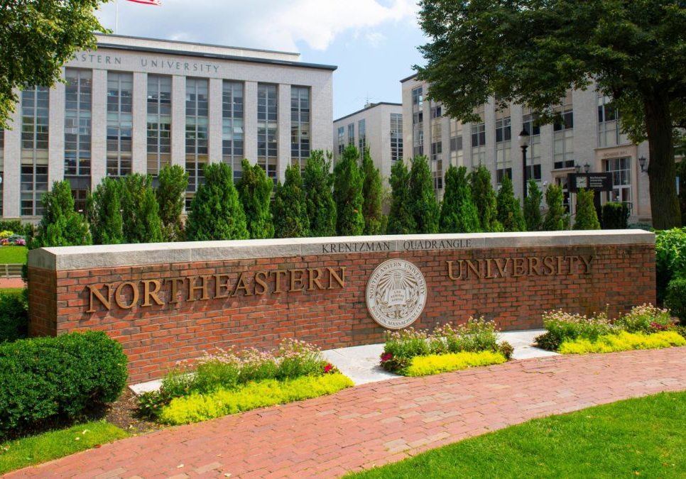
Updated Client List (Last three years)
Northeastern University
Manage multiple small projects
Project values:
$50,000 to $4.5 million

Slide 16
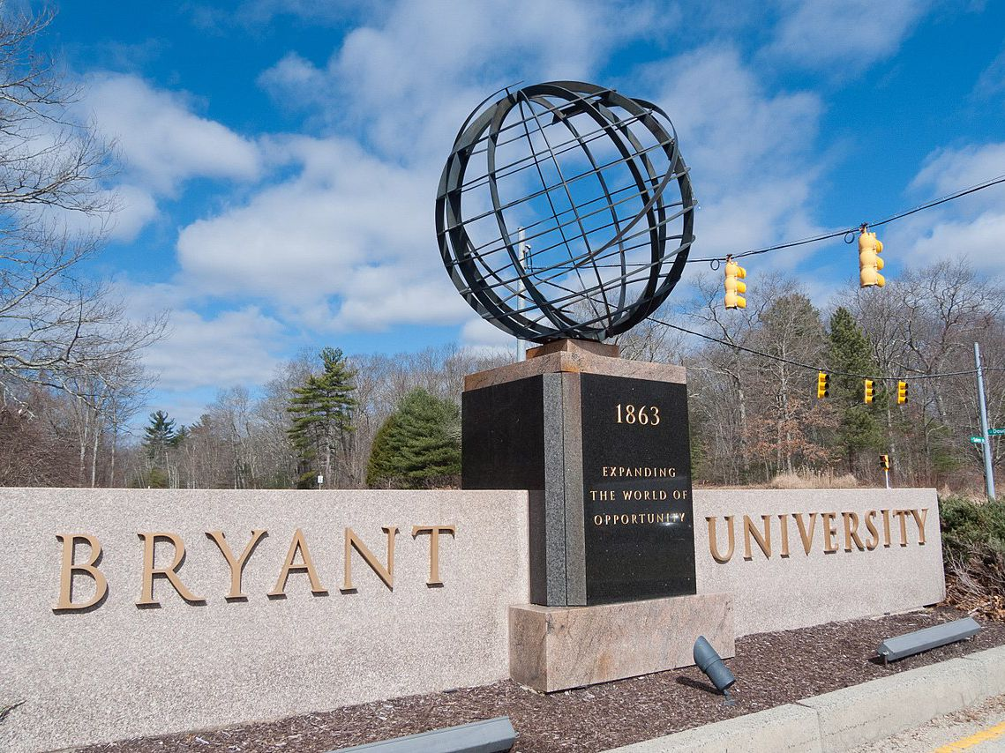
Updated Client List (Last three years)
Bryant University
Manage multiple small projects
Project values:
$300,000 to $1 million

Slide 17
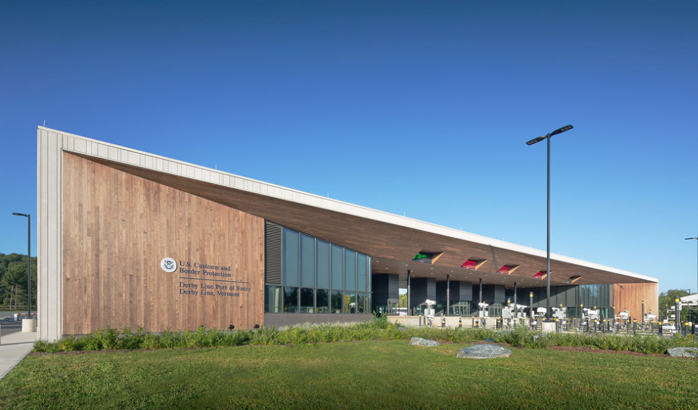
Updated Client List (Last three years)
GSA
Project Manager for new Land Port of Entry in Derby Line, VT
Project value:
$26 million

Slide 18
PRIMARY ADVISOR

Slide 19
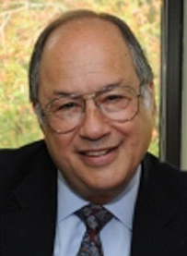
Claude Lancome
Primary point of contact with PRIM
Experience overseeing due diligence services
Experience overseeing owner’s project manager (OPM) services
Experience working for Developers
(Cummings, MCCA, Winn, Hines)
Experience advising clients on business, procurement, and contractual issues

Slide 20
SENIOR ADVISOR

Slide 21
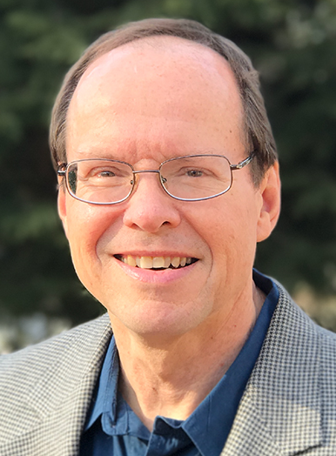
Richard Ness
Senior Advisor and primary point of contact for our assigned project managers
40-year career, held 15 different positions within AEC, real estate development, and facilities management industries
Architect, experience managing A/E teams for office, industrial, retail and apartment building types, authored numerous Property Condition Reports
Investment Advisor at VFA, consulted with owners and managers of very large building portfolios in long-term capital planning for their real estate assets (Boeing, Abbott Laboratories) and presented strategic planning topics at national conferences
Executive Manager at DHCD, gained public sector knowledge while overseeing $500M public reinvestment into 40,000 units of state-assisted apartment housing

Slide 22
PROJECT MANAGERS

Slide 23
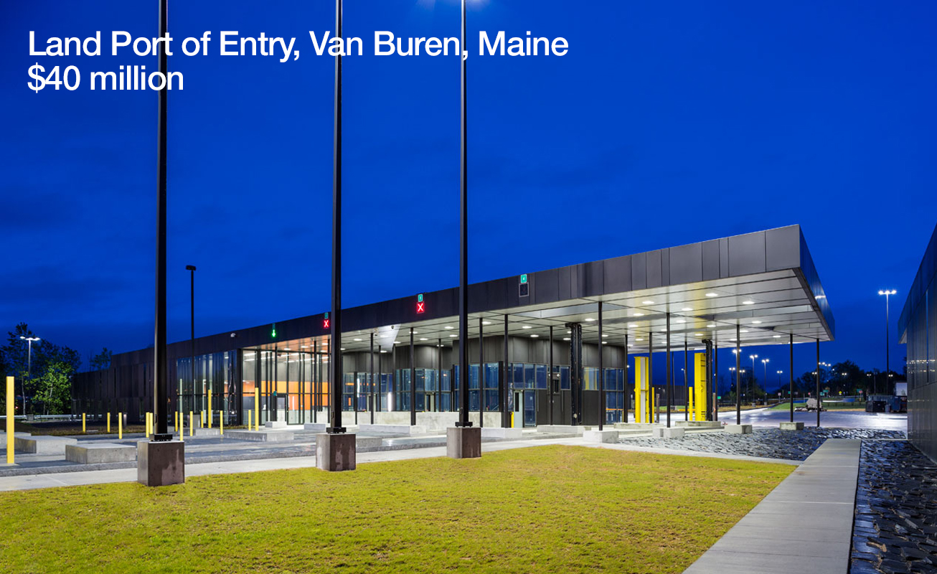

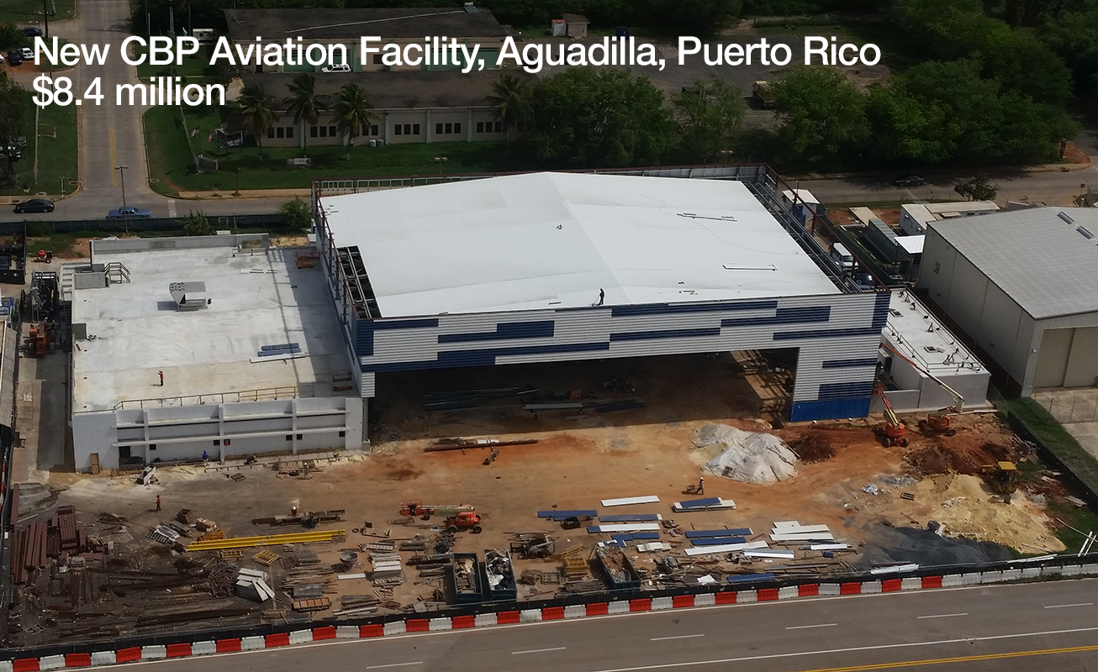
Project Managers
Assigned on an as needed basis
Have skills and experience for specific assignment
Geographic reach:
Coast and Harbor teams are carefully managed

Slide 24
COMMUNICATION CHART

Slide 25
Proposed Communications Flow
P R I M
(or PRIM’s Designated Project Advisor)
Claude Lancome, Esq.
Primary Advisor
Richard Ness, RA
Senior Advisor
Coast and Harbor
Project Manager
and/or Team
Coast and Harbor
Project Manager
and/or Team
Coast and Harbor
Project Manager
and/or Team

Slide 26
HOW COAST AND HARBOR
CAN ASSIST PRIM

Slide 27
How Coast and Harbor can Assist PRIM
Due Diligence for Acquisition or Financing: Property Condition Reports
Due Diligence for Joint Venture Partnerships: Project Monitoring
Supporting PRIM as Project Owner: Owner’s Project Management Support including Workouts
Assembling and Managing multiple member teams as needed by PRIM
Support another PRIM Consultant

Slide 28
CASE STUDIES OF RECENT PROJECT ASSIGNMENTS
(Due Diligence)

Slide 29
Case Study
Northwestern Mutual: Malden Center
a $150 million mixed use project
5-story, 250-unit apartment building with 2 levels of underground parking
6 story, 70-unit apartment building with 10,000SF of retail space
5-story office building, core and shell only

Slide 30
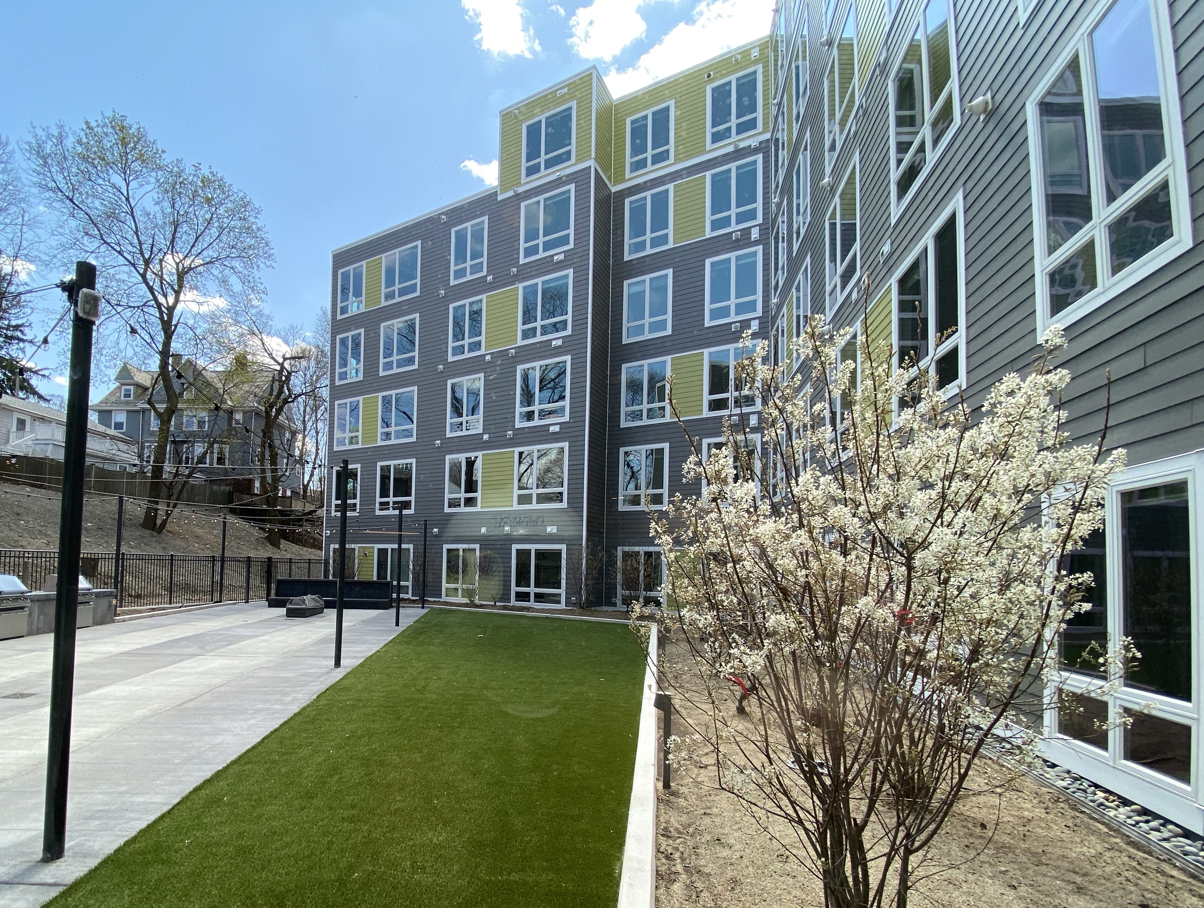
Case Study
Northwestern Mutual: Residences at Forest Hills
a $100 million mixed use project
3 buildings with 250 apartment units;
one level of underground parking underneath all 3 buildings; and
4,000SF of retail space

Slide 31
Case Study
Brown University
New $85 million School of Engineering Building and new $150 million New Performing Arts Center

Slide 32
CASE STUDIES OF RECENT PROJECT ASSIGNMENTS
(Project Management)

Slide 33
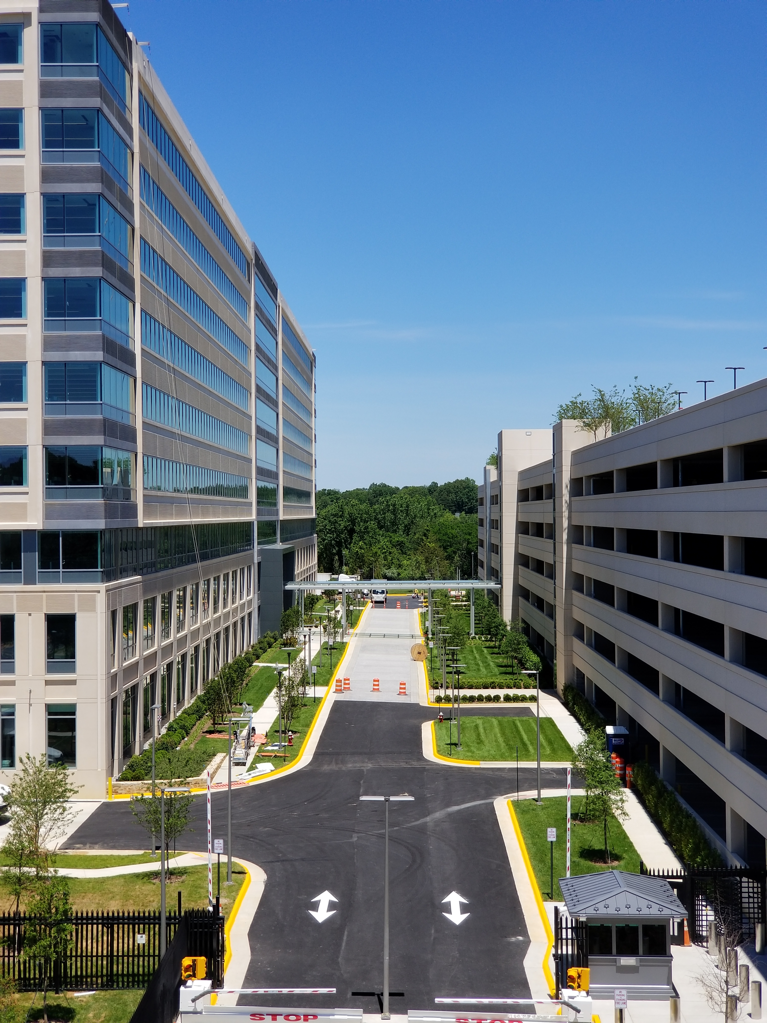
Case Study
National Capital Region of US General Services Administration
Team of 10 Senior Project Managers managing office fit-out projects with an aggregate value of $500,000,000
Signature project:
TSA new headquarters

Slide 34
Case Study
City of Providence
Program Manager for $78 Million Capital Improvement Program
Team included Program Manager and Clerk of the Works
Over 120 projects

Slide 35
BENEFITS OF WORKING WITH COAST AND HARBOR

Slide 36
Benefits of Working with Coast and Harbor
Protecting PRIM’s Interests
Providing the Right People
Reporting designed to meet PRIM’s need for information
Quality Control to ensure quality of service
We are very good at what we do
We want to work for PRIM

Slide 37
We are pleased to take your questions.

Slide 38

7 Kimball Lane, Suite D, Lynnﬁeld, MA 01940
781.224.3870 | coastandharbor.com
MBE/WBE CERTIFIED
Hispanic Woman Owned Business Enterprise

